Slide 1

Modules
Current methodology is to use loadable kernel modules
Kernel has a set of core components
Links dynamically with additional services during boot time or during run time
Implementations of UNIX using this methodology
Solaris, Mac OS X, etc.
Solaris
A core kernel with seven types of loadable modules
Reading assignment
Notes:
Linking modules dynamically; approach similar to micro kernel but it is more efficient because modules need not invoke message passing in order to communicate

Slide 2
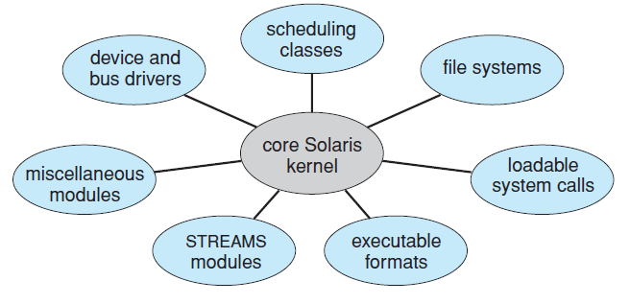
Solaris Loadable Modules

Slide 3
Hybrid Systems
Most of the operating systems are a hybrid of the previously mentioned structures
They address the issues of performance, security and usability
Linux, Solaris are monolithic but also have modular behavior
Reading assignment (contents of book)
Mac OS X iOS
Android

Slide 4
Process Management
Part 2
Processes
Threads
Process Synchronization
CPU Scheduling
Deadlocks

Slide 5
Process Management
A process is a program in execution
Needs resources to accomplish its task
System consists of a collection of processes executing concurrently
OS processes and user processes
Processes may be of single thread or may have multiple threads
OS activities for process and thread management
Creation and deletion of both user and system processes
Scheduling of processes
Provision of mechanisms for
Synchronization Communication
Deadlock handling

Slide 6
Process Concept
Definitions
States of a process
Process Control Block
Threads of a process
Scheduling and schedulers
Scheduling queues
Operations on processes
Process creation and termination
Communication between processes
A brief introduction

Slide 7
Process Concept
All activities including OS programs and user programs are termed as processes
Job and process are terms used interchangeably
A process comprises of
A program code or text section
Program counter and contents of processor registers
Process stack and a data section
It may also contain a heap that is dynamically allocated at run time
Two processes may be associated with the same program but are considered to be separate processes

Slide 8
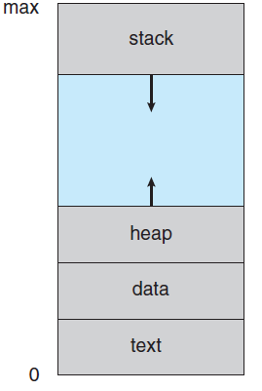
Process in Memory

Slide 9
Process State
Processes change states as they execute
New: The process is being created
Running: Instructions are being executed
Only one process can be running on a processor in system at any instant
Waiting: The process is waiting for some event to occur
Ready: The process is waiting to be assigned to the processor
Many processes may be ready and waiting
Terminated: The process has completed execution

Slide 10
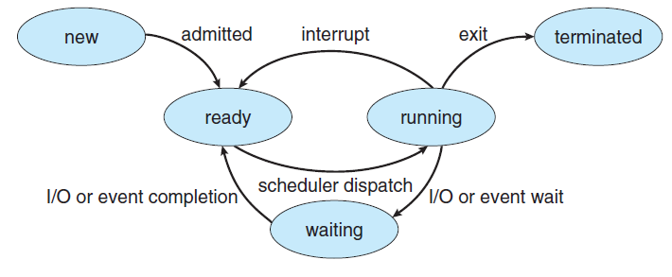
Diagram of Process State

Slide 11
Process Control Block
Each process in the system is represented by a task control or a process control block (PCB)
PCB serves as the repository for information that may vary from process to process
Includes the following information
Process state
Program counter
CPU registers
Number and type depends on the processor architecture
CPU scheduling information
Contains scheduling parameters
Memory management information
Accounting information
I/O state information

Slide 12
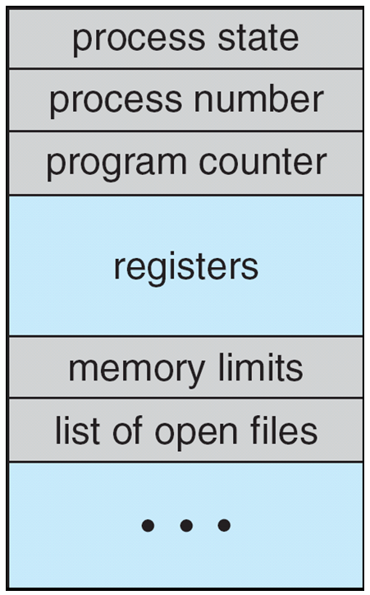
Process Control Block (PCB)

Slide 13
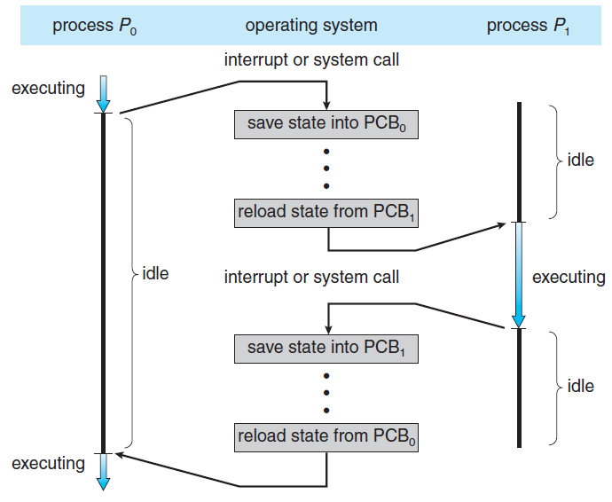
CPU Switch From Process to Process

Slide 14
Threads
The process model implies that a process performs a single thread of execution
A single thread of instructions
Allows the process to execute only one task at a time
Current generation OS allow a process to perform multiple threads of execution at a time
Perform more than one task at a time

Slide 15
Process Scheduling
Process scheduler performs both time sharing and multiprogramming among processes
Selects an available process for execution on the CPU
Scheduling Queues
Job queue consists of all processes in the system
Ready queue consists of all processes that are residing in main memory waiting to execute
Generally stored as a linked list
Ready queue header and pointer field of each PCB
System includes other queues too
Device queue contains a list of processes waiting for a particular device

Slide 16
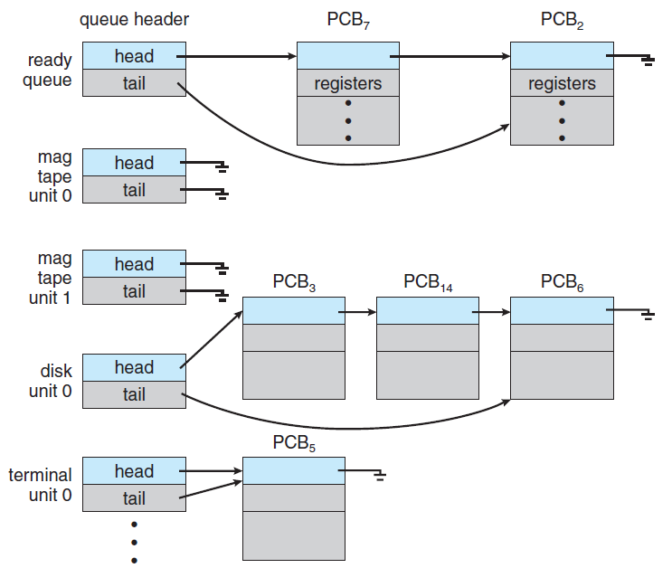
Ready Queue And Various I/O Device Queues

Slide 17
Scheduling Queues
A queuing diagram represents process scheduling
A new process is placed in a ready queue
It waits until it is selected for execution or is dispatched
One of several events may occur while the process is in execution
Process issues an I/O request and is placed in an I/O queue
Process creates a child process and waits for the child’s termination
Process eventually goes back to ready queue
Process is interrupted and put in ready queue
Process continues with this cycle until it terminates and releases all its resources

Slide 18
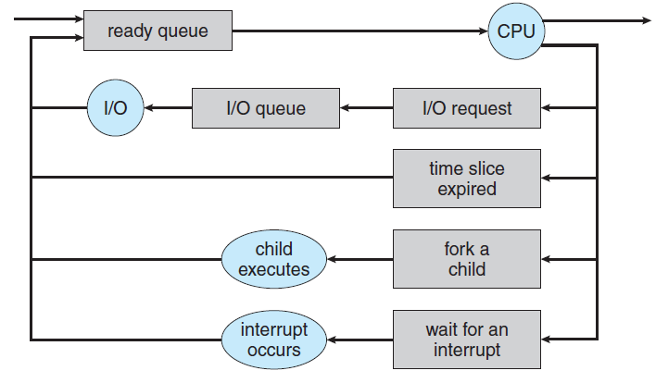
Representation of Process Scheduling

Slide 19
Schedulers
Schedulers select a process from any of the given queues
Long-term scheduler or job scheduler selects processes from job pool and loads them into memory
Short-term scheduler or CPU scheduler selects from the processes that are ready for execution in memory
Frequency of execution of short-term scheduler is much higher than a long-term scheduler
It should be fast
Long-term scheduler controls the degree of multiprogramming (DOM)
If DOM is stable, average rate of process creation is equal to the average rate of departure of process after termination

Slide 20
Schedulers
I/O-bound processes spend more time performing I/O than doing computations
CPU-bound processes spend more time in computation than in I/O
Long-term scheduler should make a careful selection of process mix
Some time-sharing systems do not have long-term scheduler
Stability of these systems depend on a physical limitation or the self-adjusting nature of humans
There may be a medium-term scheduler in some time-sharing systems
It can be beneficial to remove a process from memory to reduce the DOM

Slide 21
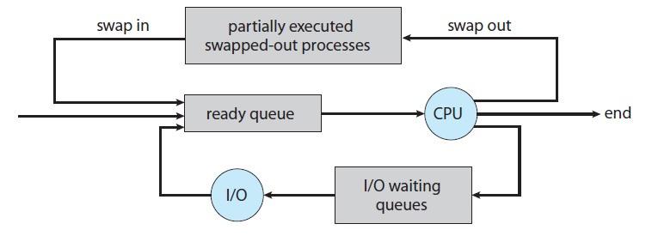
Addition of Medium Term Scheduling

Slide 22
Context Switch
When the CPU is interrupted, it saves the state of the current process and restores the state later to resume
Save and restore operation takes place in kernel mode
Switching the CPU to another process requires state saving and restoring state of another process
Context switch time is overhead
It is dependant on hardware support
Some processors provide multiple sets of registers
Context switch involves only the change of a pointer

Slide 23
Operations on Processes
Most systems provide a mechanism for process creation and termination
Process Creation
A process may create new processes through a create-process system call
Parent and child processes form a tree of processes
Process identifier (pid) uniquely identify processes in a system
When a process creates a child process, it may get its resources
Directly from the OS or it may be allocated a subset of resources of the parent process
Initialization data is also passed on to the child process

Slide 24
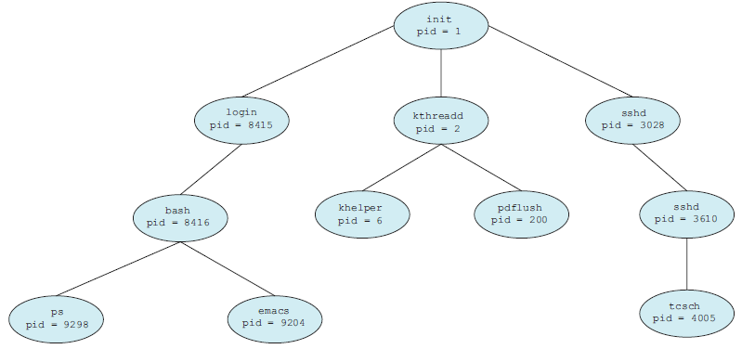
A tree of processes on a typical Linux system

Slide 25
Operations on Processes
Two possibilities exist in terms of execution when a process creates another process
The parent continues to execute concurrently with the child processes
The parent waits until some or all of its children have terminated
In terms of address space of the new process
The child process is an exact duplicate of the parent process
The child process has a new program loaded into it
Illustrate the differences between the above through UNIX OS
Process creation in Windows
Reading assignment

Slide 26
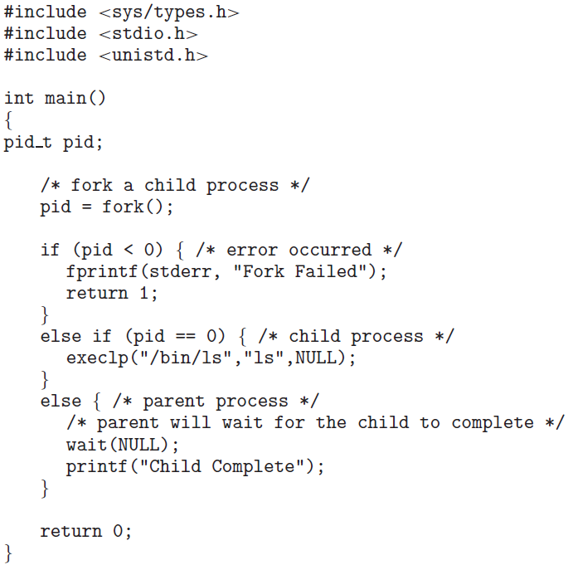
C Program Forking Separate Process

Slide 27
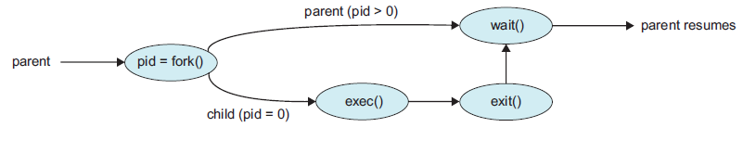
Process Creation

Slide 28
Operations on Processes
Process Termination
A process terminates when it finishes executing its final statement – exit()
All resources of the process are deallocated and it may return a status value to its parent process
Termination can also be caused by another process through a system call
Only the parent process can terminate
Reasons for termination can be
The child process has exceeded the usage of some of its resources
The task assigned to child is no longer required
The parent is exiting and the OS does not allow the child to continue
Cascading termination may take place

Slide 29
Interprocess Communication
Processes executing concurrently in a system are either independent or cooperating
Independent processes cannot affect or be affected by other executing processes in system
Cooperating processes can affect and be affected by other processes
Why cooperating processes?
Information sharing can be done by allowing concurrent access to same set of information
Computation speedup can be achieved by breaking a task into subtasks that execute in parallel
Modularity is achieved by constructing the system in a modular fashion

Slide 30
Interprocess Communication
Convenience is provided for users by allowing several tasks to be executed in parallel
Cooperating processes require an interprocess communication (IPC) mechanism
Two models exist for IPC
Shared memory model
A region of memory is created that is shared by cooperating processes
Allows maximum speed and convenience of communication
Message passing model
Messages are exchanged between cooperating processes
Useful for exchange of smaller amount of data and is easier to implement

Slide 31
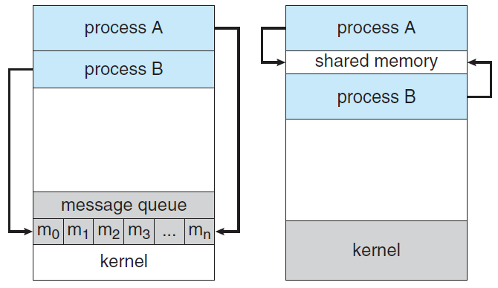
Communications Models
Message Passing
Shared Memory

Slide 32
CPU Scheduling
Algorithms for CPU Scheduling
Evaluation of Various Scheduling Algorithms
Notes:
Page 285

Slide 33
Overview of Contents
CPU scheduling algorithms
FCFS
SJF
Priority
Round-Robin
Preemptive and non-preemptive algorithms
Multilevel queue algorithms
Multilevel feedback-queue algorithms
Thread scheduling
Multiple-processor scheduling
Real-time CPU scheduling
Performance of scheduling algorithms

Slide 34
Introduction
CPU scheduling is the basis of multiprogrammed OS
Computer becomes more productive by switching the CPU among processes
The problem of selecting a particular CPU scheduling algorithms from among a number of algorithms
Process scheduling and thread scheduling

Slide 35
Some Basic Definitions and Concepts
In a single process environment, CPU is idle when the process is waiting for an I/O request
Multiprogramming helps use this time productively
Another process can run on the CPU in case a running process waits for such events
Basic CPU scheduling algorithm
CPU-I/O Burst Cycle
Process execution consists of a cycle of CPU execution and I/O wait
CPU burst and I/O burst
Duration of CPU burst and their frequency curve
Exponential or hyper-exponential

Slide 36
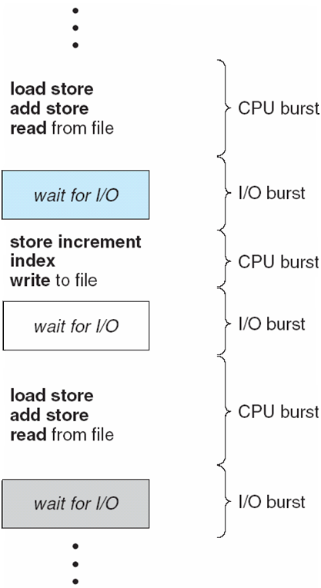
Alternating Sequence of CPU And I/O Bursts
Notes:
36

Slide 37
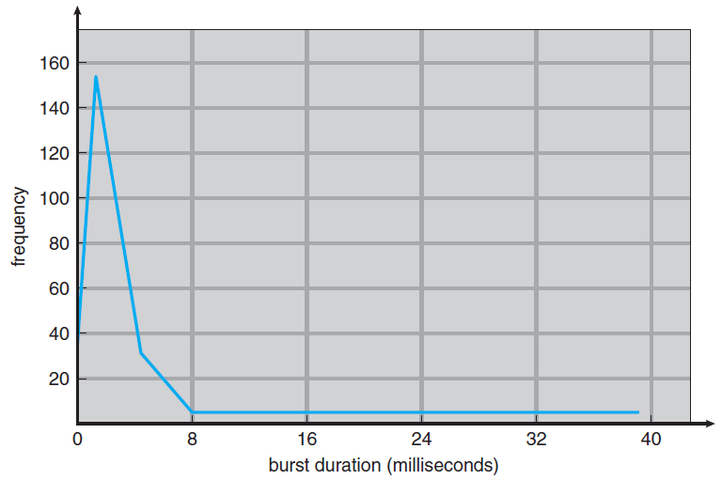
Histogram of CPU-burst Durations
Notes:
37

Slide 38
Basic Concepts
Consists of a large number of short CPU bursts and a small number of long CPU bursts
I/O bound and CPU bound processes
Short-term or CPU Scheduler
Selects a process from the processes in memory that are ready to execute and allocates the CPU to the process
Ready queue can be either
A FIFO queue
A priority queue
A tree
An unordered linked list
Records in the queue are PCBs

